Slide 1
Cross-talk Free Control of Multimode Cavities with Conditional Displacements
Eesh Gupta, S. Chakram, …

Slide 2
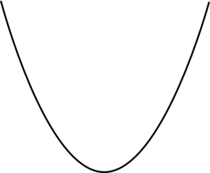
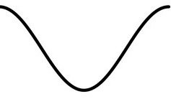
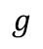
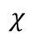
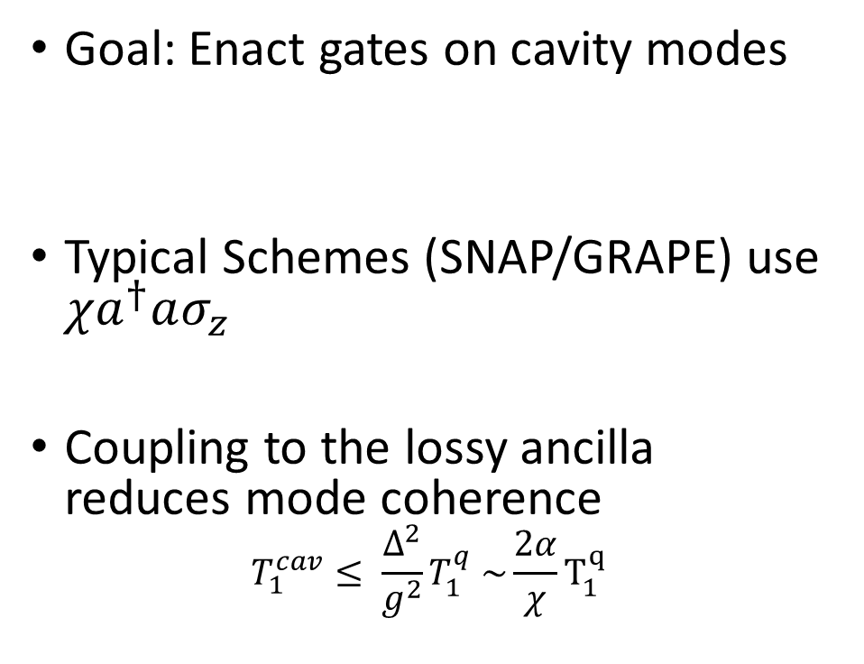
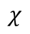
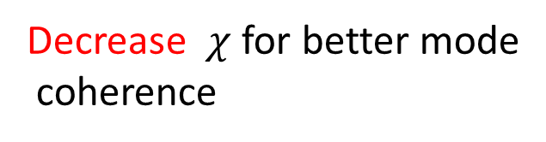
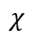

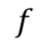
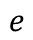
Motivation
Goal: Enact gates on cavity modes
Typical Schemes (SNAP/GRAPE) use $χa^{†}aσ_{z}$
Coupling to the lossy ancilla reduces mode coherence
$$T_{1}^{cav}≤ \frac{Δ^{2}}{g^{2}}T_{1}^{q} \sim \frac{2α}{χ}T_{1}^{q}$$
$$χ$$
$$f$$
$$e$$
$$χ$$
Increase $χ$ for faster gates
$$g$$
$$χ$$
Decrease $χ$ for better mode
coherence
Notes:
1. Transmon offers the desired non-linearity
2. Schemes such as SNAP and Grape use the dispersive interaction
3. Coupling introduces loss into the cavity --

Slide 3
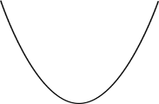
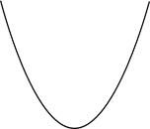
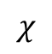
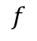
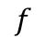
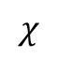
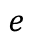
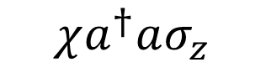
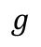
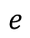
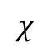
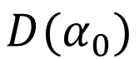
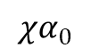
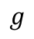
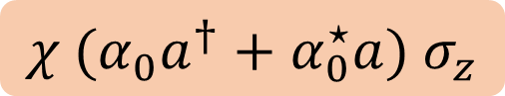
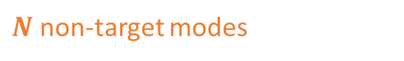
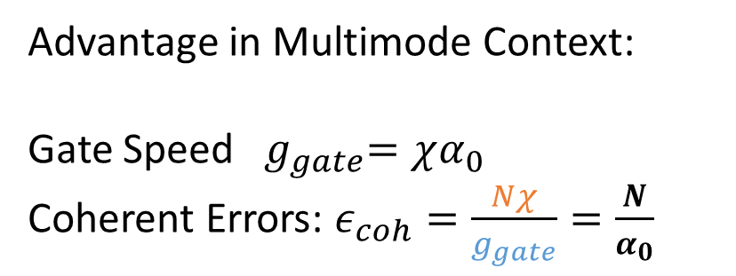
Large Displacements
$$f$$
$$e$$
$$g$$
$$χa^{†}aσ_{z}$$
$$χ{ (α_{0}a}^{†}+α_{0}^{⋆}a) σ_{z}$$
$$D(α_{0})$$
$$χα_{0}$$
Advantage in Multimode Context:
Gate Speed ${ g}_{gate}=χα_{0}$
Coherent Errors: $ε_{coh}=\frac{Nχ}{g_{gate}}=\frac{N}{α_{0}}$
$$χ$$
$$f$$
$$e$$
$$χ$$
$$g$$
$$χ$$
$N$ non-target modes
Hacohen-Gourgy, S., Martin, L., Flurin, E. et al. Nature 538, 491–494 (2016).
Eickbusch, A., Sivak, V., Ding, A.Z. et al. Nat. Phys. 18, 1464–1469 (2022)

Slide 4
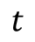

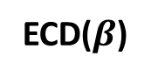
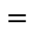
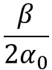
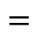
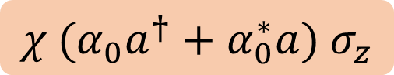
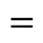
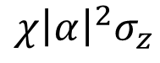
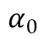
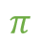
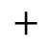
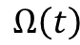
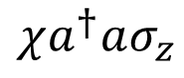
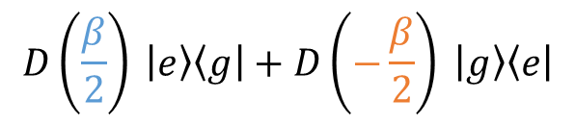

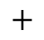
Echoed Conditional Gates
$$χ\left(a^{†}+α^{∗}\right)\left(a+α\right)σ_{z}$$
$$=$$
$$χ{ (α_{0}a}^{†}+α_{0}^{∗}a) σ_{z}$$
$$χ{\left|α\right|}^{2}σ_{z}$$
$$χa^{†}aσ_{z}$$
$$+$$
$$+$$
$$α_{0}$$
$$ε\left(t\right)$$
Mode
ECD($β$)
$$D\left(\frac{β}{2}\right) \left|e\right\rangle \left\langle g\right|+D\left(−\frac{β}{2}\right) \left|g\right\rangle \left\langle e\right|$$
$$t$$
$$=$$
$$=$$
$$\frac{β}{2α_{0}}$$
Qubit
$$Ω\left(t\right)$$
$$π$$
A. Eickbusch, ..., R. Schoelkopf, M. Devoret. ArXiv preprint arXiv:2111.06414 (2021)

Slide 5

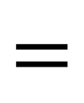

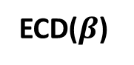

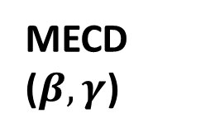
Multimode ECD
Mode 1
MECD ($β,γ$)
Mode 1
ECD($γ$)
$$=$$
Mode 2
Mode 2
ECD($β$)
$$R_{φ}(θ)$$
Universal Control for Two Modes
Not simultaneously driving each mode to prevent heating of modes [1,2]
Qubit
Qubit
$$R_{φ}(θ)$$
[1] Eickbusch, Alec , et al. W34. 00005. APS March Meeting (2022).
[2] Diringer, Asaf A., et al. arXiv preprint arXiv:2301.09831 (2023).

Slide 6
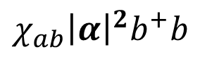







Two Mode ECD : Unwanted Cross Kerr Terms
Displaced Frame Transformation
$$χ_{ab}a^{+}a b^{+}b$$
$$χ_{ab}{(a}^{+}+α^{∗})(a+α)(b^{+}+β^{∗})(b+β)$$
Terms of form :
How to avoid :
$$χ_{ab}αβ a^{+}b^{+}$$
$α, β$should not be simultaneously nonzero
$$χ_{ab}{\left|α\right|}^{2}β b^{+}$$
Echoed out when $β$ flips
Make $χ_{ab}≪χ_{a}, χ_{b}≈10$kHz
Note $χ_{ab}=\sqrt{κ_{a}κ_{b}}=\frac{χ_{a}χ_{b}}{α′}≈0.33$Hz … good!
($α^{′}≤$ 300 MHz for transmons)
$χ_{ab}{\left|α\right|}^{2}b^{+}b$

Slide 7


Two Mode ECD: State Transfer
$$g⊗\left|0n\right\rangle →g⊗|n0⟩$$

Slide 8

















Two Mode ECD: State Transfer
Mode 2
ECD($γ_{1}$)
ECD($γ_{2}$)
ECD($γ_{N}$)
Mode 1
ECD($β_{1}$)
ECD($β_{2}$)
ECD($β_{N}$)
Qubit
$${ R}_{φ_{1}}(θ_{1})$$
$${ R}_{φ_{1}}(θ_{2})$$
$${ R}_{φ_{1}}(θ_{N})$$
Mode 2
ECD($γ_{N}$)
ECD($γ_{N}$)
Mode 1
ECD($β_{1}$)
ECD($β_{N}$)
Qubit
$${ R}_{φ_{1}}(θ_{1})$$
$${ R}_{φ_{N}}(θ_{N})$$
$${ R}_{φ_{1}}(θ_{1})$$
$${ R}_{φ_{1}}(θ_{N})$$

Slide 9




Two Mode ECD: State Transfer
$$g⊗(\left|0\right\rangle →|n⟩)$$
$$g⊗\left( \left|n0\right\rangle → | 0n\right\rangle )$$
$$g⊗(\left|n\right\rangle →|0⟩)$$
Notes:
Compare with Single Mode ECD Results

Slide 10

Multimode ECD: Error Budget

Slide 11

Transmon Relaxation
Reduction in Errors if use better qubits i.e. fluxonium

Slide 12






Circle Grape
$$H=χ\left(αa^{†}+α^{∗}a\right)σ_{z}$$
$$Im(α)$$
Continuously varying Qubit Drive (optimized)
Includes detuning
Simultaneously driving of the modes
$$Re(α)$$
$$H=Δ_{c}a^{†}a+ χ\left(αa^{†}+α^{∗}a\right)σ_{z}$$
$$Im(α)$$
Rotate in circle because of detuning; is this a spiral?
$$Re(α)$$

Slide 13






ECD
Circle Grape
$$α_{0}$$
$$ε\left(t\right)$$
$ε\left(t\right)=Δ_{c}∗α_{0}$
$$t$$
$$\frac{t_{w }}{2}$$
$$t$$
$$Ω\left(t\right)$$
$$π$$
$$R_{φ}(θ)$$
Optimizer
$$\vec{β}=α_{0}\vec{t_{w}} \vec{φ} , \vec{θ}$$
Optimizer
$$Ω_{x}\left(t\right), Ω_{y}(t)$$

Slide 14

Circle Grape: g01 -> g10

Slide 15

Comparing Grape and MECD
ECD
Circle Grape

Slide 16



Circle Grape Results
$$g⊗(\left|0\right\rangle →|n⟩)$$
$$g⊗\left( \left|n0\right\rangle → | 0n\right\rangle )$$
$$g⊗(\left|n\right\rangle →|0⟩)$$

Slide 17

Uniting with other schemes: Dealing with Unwanted Terms
The displaced frame transformation, however, divides the initial ac-Stark shift term into the following 3 terms
Sideband Drives
Make terms oscillate at different frequencies
Invoke RWA in a frame where only desired term is stationary
Echoed Cond. Displacements
Terms have different no. of α’s but only a single $σ_{z}$
Clever flipping of α and $σ_{z}$ can echo out unwanted terms

Slide 18
















Sideband Drives
Since $α$ oscillatory,
https://arxiv.org/pdf/1608.06652.pdf
$$H=χa^{+}aσ_{z }+χ\left(αa^{+}+α^{∗}a\right)σ_{z}+χ{\left|α\right|}^{2}σ_{z}+Ω_{R}σ_{x}$$
$$ω=0$$
$$ω=Ω_{R }$$
$$ω={2Ω}_{R }$$
$$ε\left(t\right)∝α_{0}sin⁡(Ω_{R}t+δ)$$
Frame Transformations:
$σ_{x}↔σ_{z}$
Rotating Frame of the qubit
t
$$δ$$
$$Ω_{R}σ_{z}$$
$$Ω_{R}σ_{z}$$
$$α\left(t\right)∝α_{0}cos(Ω_{R}t+δ)$$
$$H=χα_{0}\left(a^{+}+a\right)⊗(σ_{x}\cos{δ+σ_{y}\sin{δ )}} + …$$
t
$$cos⁡(δ)$$
$$ω=0$$
$$ω≥ Ω_{R}$$
Shay Hacohen-Gourgy, …, Irfan Siddiqi. Nature 538-7626 (2016).

Slide 19










Prev. Work: Echoed Cond. Disp.
$$α\left(t\right)$$
$$Ω(t)$$
t
Not completely
echoed out !
$$χa^{+}aσ_{z}$$
$$χa^{+}a(−σ_{z})$$
Echo
$$χ\left(αa^{+}+α^{∗}a\right)σ_{z}$$
$$χ\left(αa^{+}+α^{∗}a\right)σ_{z}$$
$$χ{|α|}^{2}σ_{z}$$
$$χ{|α|}^{2}{(−σ}_{z} )$$
A. Eickbusch, ..., R. Schoelkopf, M. Devoret. ArXiv preprint arXiv:2111.06414 (2021)

Slide 20
Conclusions and Future Work
Suppression of cross-talk errors by chi alpha schemes
Achieve >0.999 fidelity for fock state transfer using Double ECD
Speed Limit seems to be 1/chi * alpha
Future Work:
Unite with other schemes

Slide 21

Circle Grape
$$H=χa^{+}aσ_{z }+χ\left(α_{0}a^{+}+α_{0}^{∗}a\right)σ_{z}+$$
$$χ{\left|α_{0}\right|}^{2}σ_{z}+Ω(t)σ_{x}$$
Sent to Optimizer
Continuous version
Currently uses simulatenous drives
Phase Space Dynamics

Slide 22

Multimode ECD
Mode 1
MECD ($β,γ$)
Mode 1
ECD($γ$)
$$=$$
Mode 2
Mode 2
ECD($β$)
$$R_{φ}(θ)$$
Qubit
Qubit
$$R_{φ}(θ)$$
$$MECD\left(β, γ\right)=\left(\begin{matrix}D_{1}\left(−\frac{β}{2}\right)D_{2}\left(\frac{γ}{2} \right) & 0 \\ 0 & D_{1}\left(\frac{β}{2}\right)D_{2}\left(−\frac{γ}{2}\right)\end{matrix}\right)$$
Notes:
$$MECD\left(β, γ\right)=D_{1}\left(−\frac{β}{2}\right)D_{2}\left(\frac{γ}{2} \right) \left|g\right\rangle \left\langle g\right|+D_{1}\left(\frac{β}{2}\right)D_{2}\left(−\frac{γ}{2}\right) \left|e\right\rangle \left\langle e\right|$$
Not simultaneously driving each mode to prevent heating of modes (cite CNOD paper)
Downside: speed of gates is $1/χα_{0}$

Slide 23



Prev. Work: Echoed Cond. Disp.
Parameter Optimization
$$ECD\left(β\right)=D\left(\frac{β}{2}\right) \left|e\right\rangle \left\langle g\right|+D\left(−\frac{β}{2}\right) \left|g\right\rangle \left\langle e\right|$$
Pulse Optimization
A. Eickbusch, ..., R. Schoelkopf, M. Devoret. ArXiv preprint arXiv:2111.06414 (2021)
Notes:
Parameter Optimization
- Pulse Optimization
Echo out unwanted terms$(χ{|α|}^{2}σ_{z}$ and $χa^{+}aσ_{z}$) by constructing symmetric pulses for cavity drive.
Use semi-classical phase space treajectory method to find pulses which realize target displacements $\vec{β}$

Slide 24








Prev. Work: Echoed Cond. Disp.
Parameter Optimization
Pulse Optimization
$$ε\left(t\right)$$
$$Ω\left(t\right)$$
$$t$$
$$α\left(t\right)$$
t
$$|g⟩$$
$$|e⟩$$
$$Im(α)$$
$$Re(α)$$
A. Eickbusch, ..., R. Schoelkopf, M. Devoret. ArXiv preprint arXiv:2111.06414 (2021)
Notes:
Parameter Optimization
- Pulse Optimization
Echo out unwanted terms$(χ{|α|}^{2}σ_{z}$ and $χa^{+}aσ_{z}$) by constructing symmetric pulses for cavity drive.
Use semi-classical phase space treajectory method to find pulses which realize target displacements $\vec{β}$

